Slide 1

Heart Disease Risk Detection Through Predictive Modeling.
Capstone Project - SCTP Associate Data Analyst
By: Chua Wee Ming
Date: 31/07/2025

Slide 2
The Problem:
Heart disease is a leading cause of mortality worldwide. Early detection and accurate prediction of heart disease can significantly improve patient outcomes by enabling timely intervention and preventive measures. The objective of this project is to develop a machine learning model that can effectively predict the presence or absence of heart disease based on various medical and lifestyle factors.

Slide 3
The Objective:
To build a simple machine learning model that predicts the risk of heart disease from provided demographic, clinical, and lifestyle factors, which can be utilized in a clinical setting that supports early detection and enables timely intervention.

Slide 4
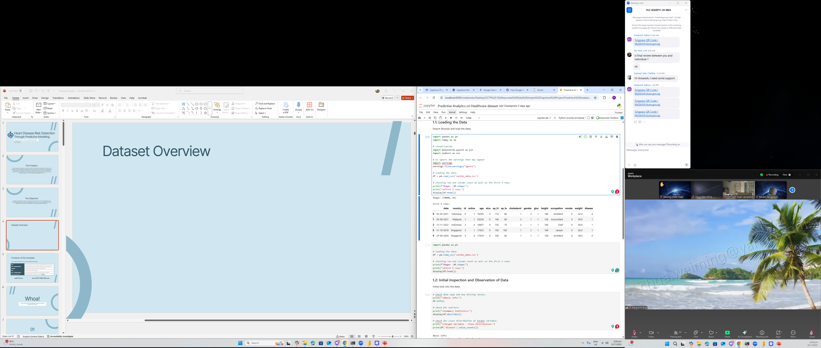
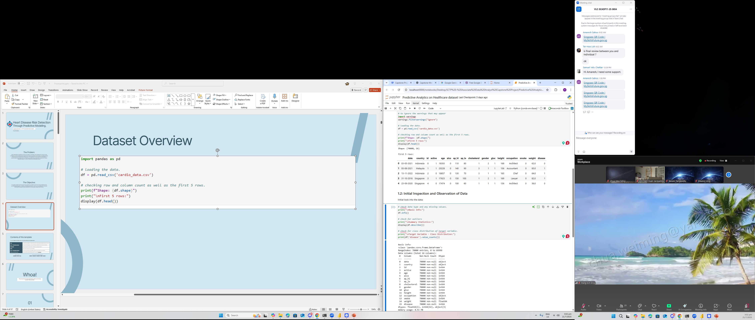
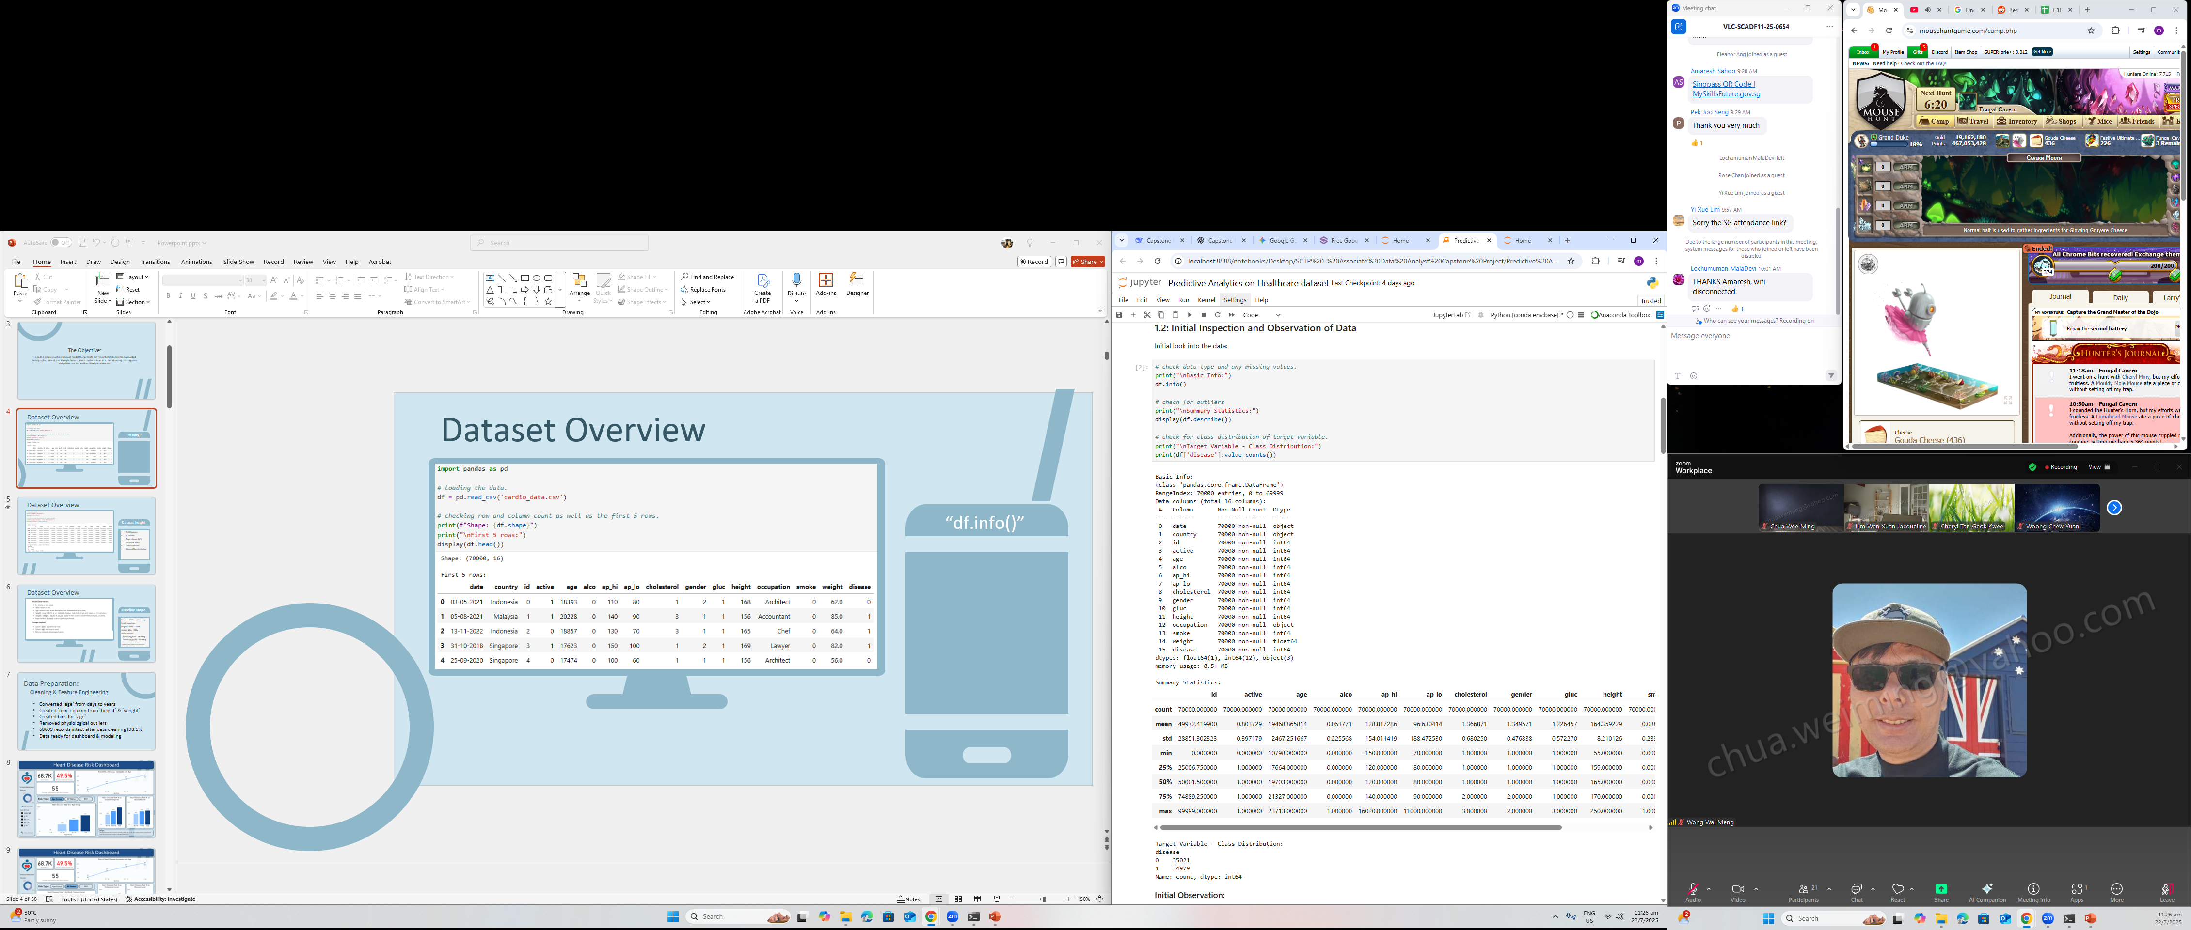
Dataset Overview
“df.info()”

Slide 5
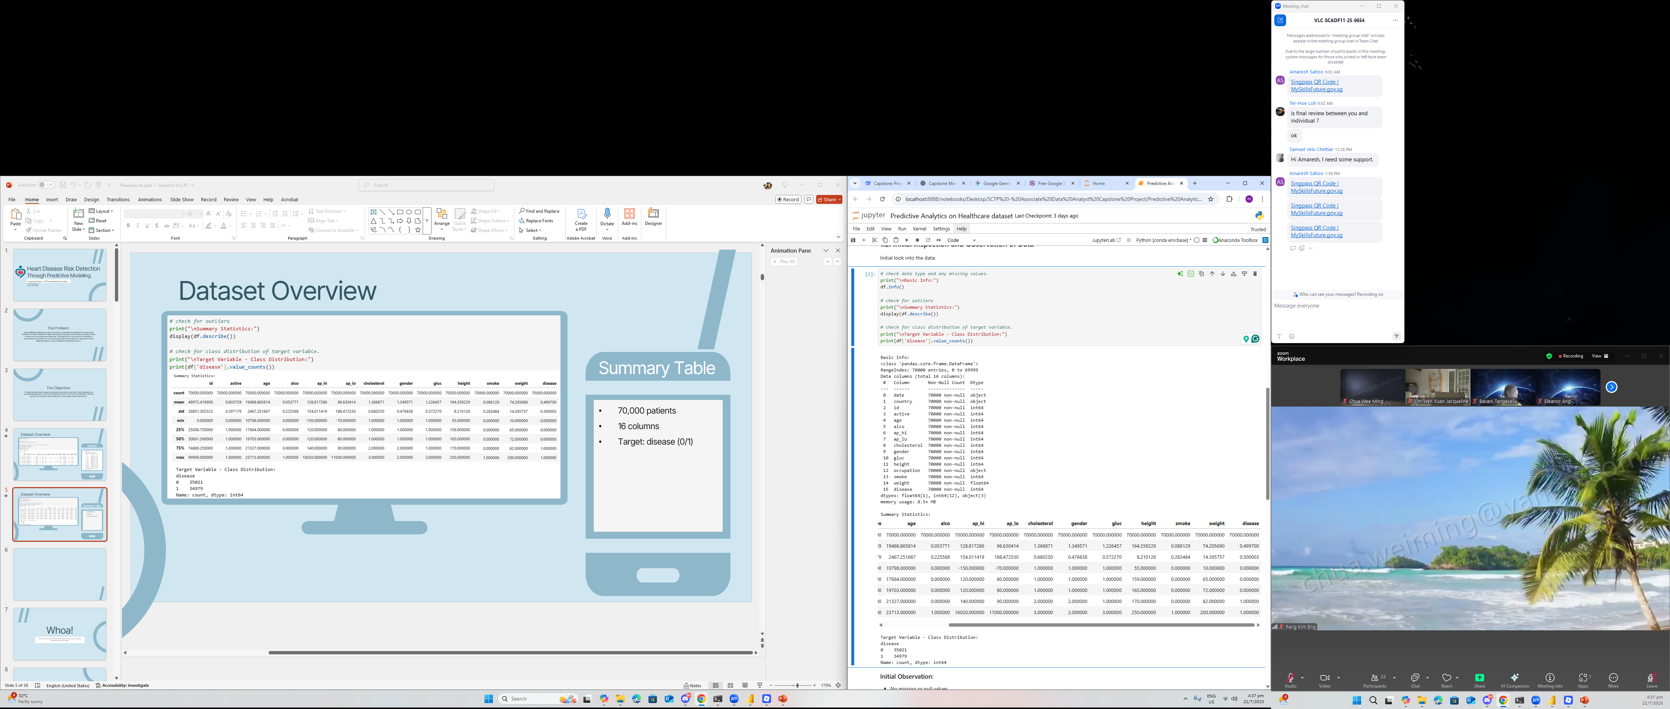
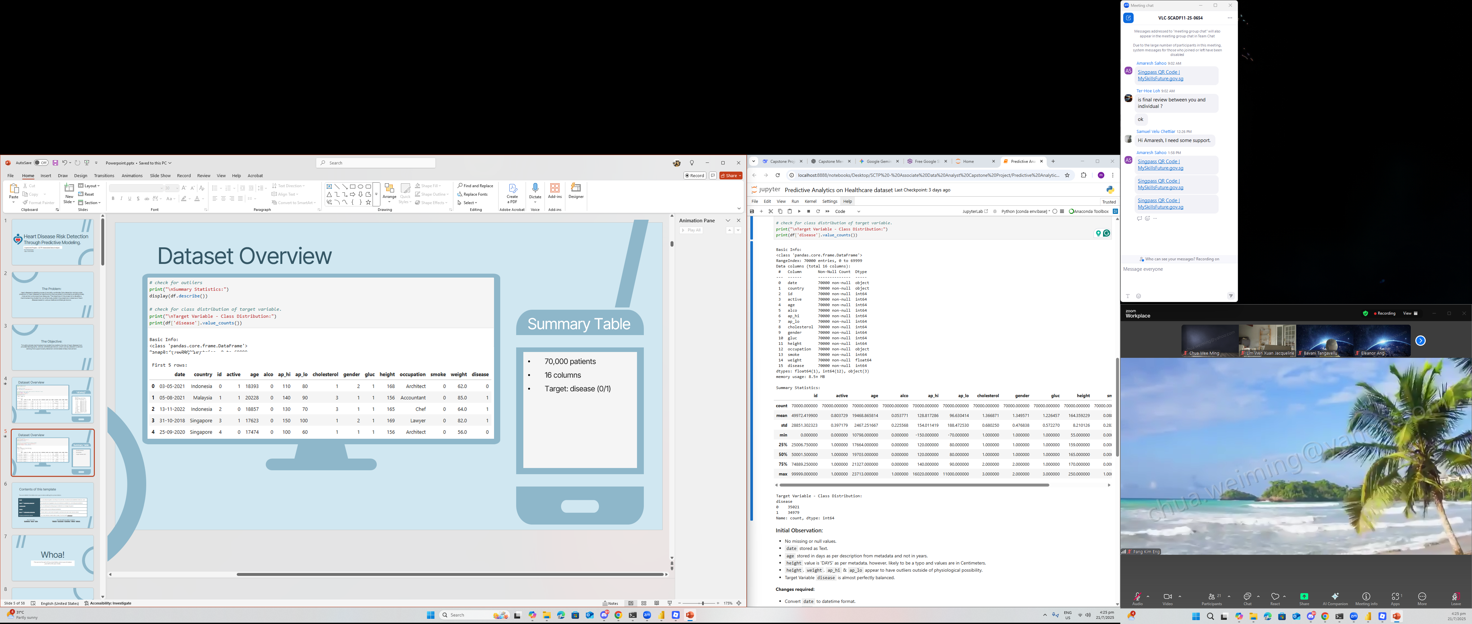
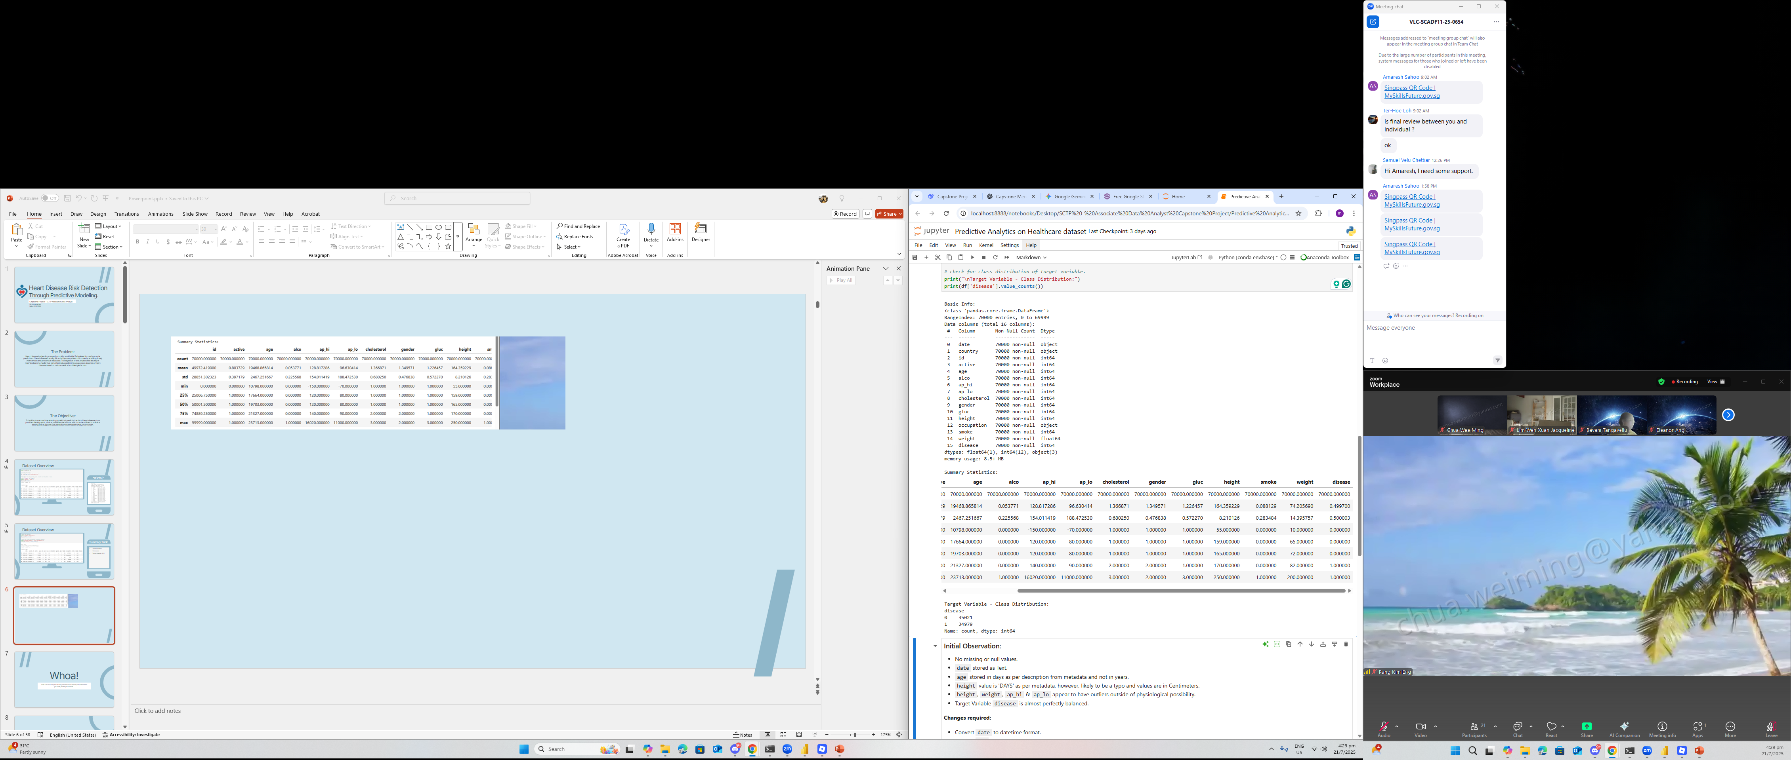
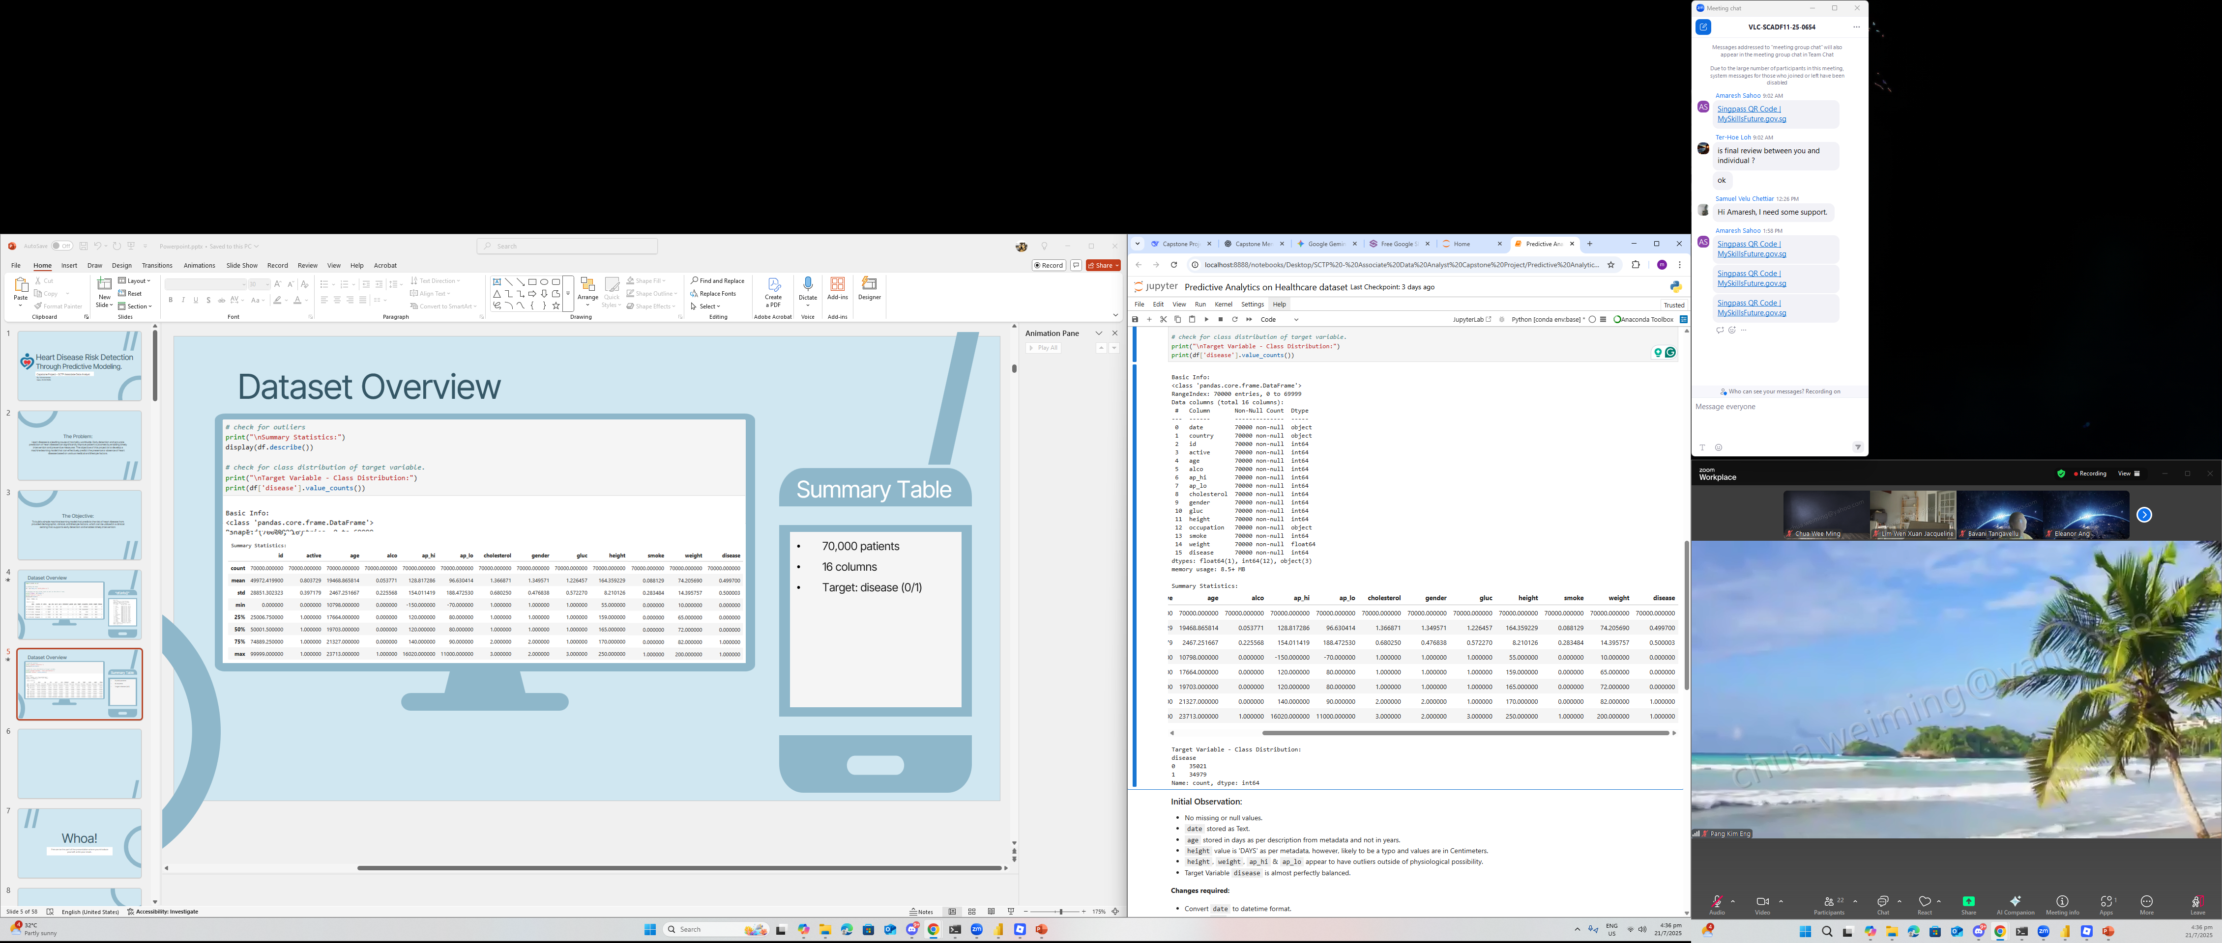
Dataset Overview
Dataset Insight
70,000 patients
16 columns
Target: disease (0/1)
No missing values
Outliers detected
Balanced Class distribution

Slide 6
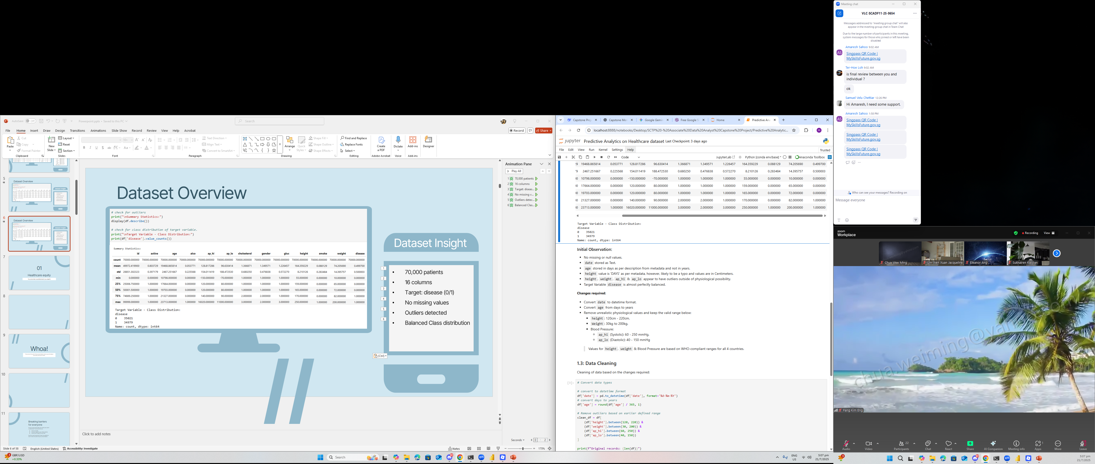
Dataset Overview
Baseline Range
Based on WHO compliant range for all 4 countries:-
Height: 120cm – 220cm
Weight: 30kg – 200kg
Blood Pressure:
Systolic (ap_hi): 60 – 250 mmHg
Diastolic (ap_lo): 40 – 150 mmHg
* range adjusted to account for rare cases such as dwarfism or extreme obesity.

Slide 7
Data Preparation: Cleaning & Feature Engineering
Converted `age` from days to years
Created `bmi` column from `height` & `weight`
Created bins for `age`
Removed physiological outliers
68699 records intact after data cleaning (98.1%)
Data ready for dashboard & modeling

Slide 8
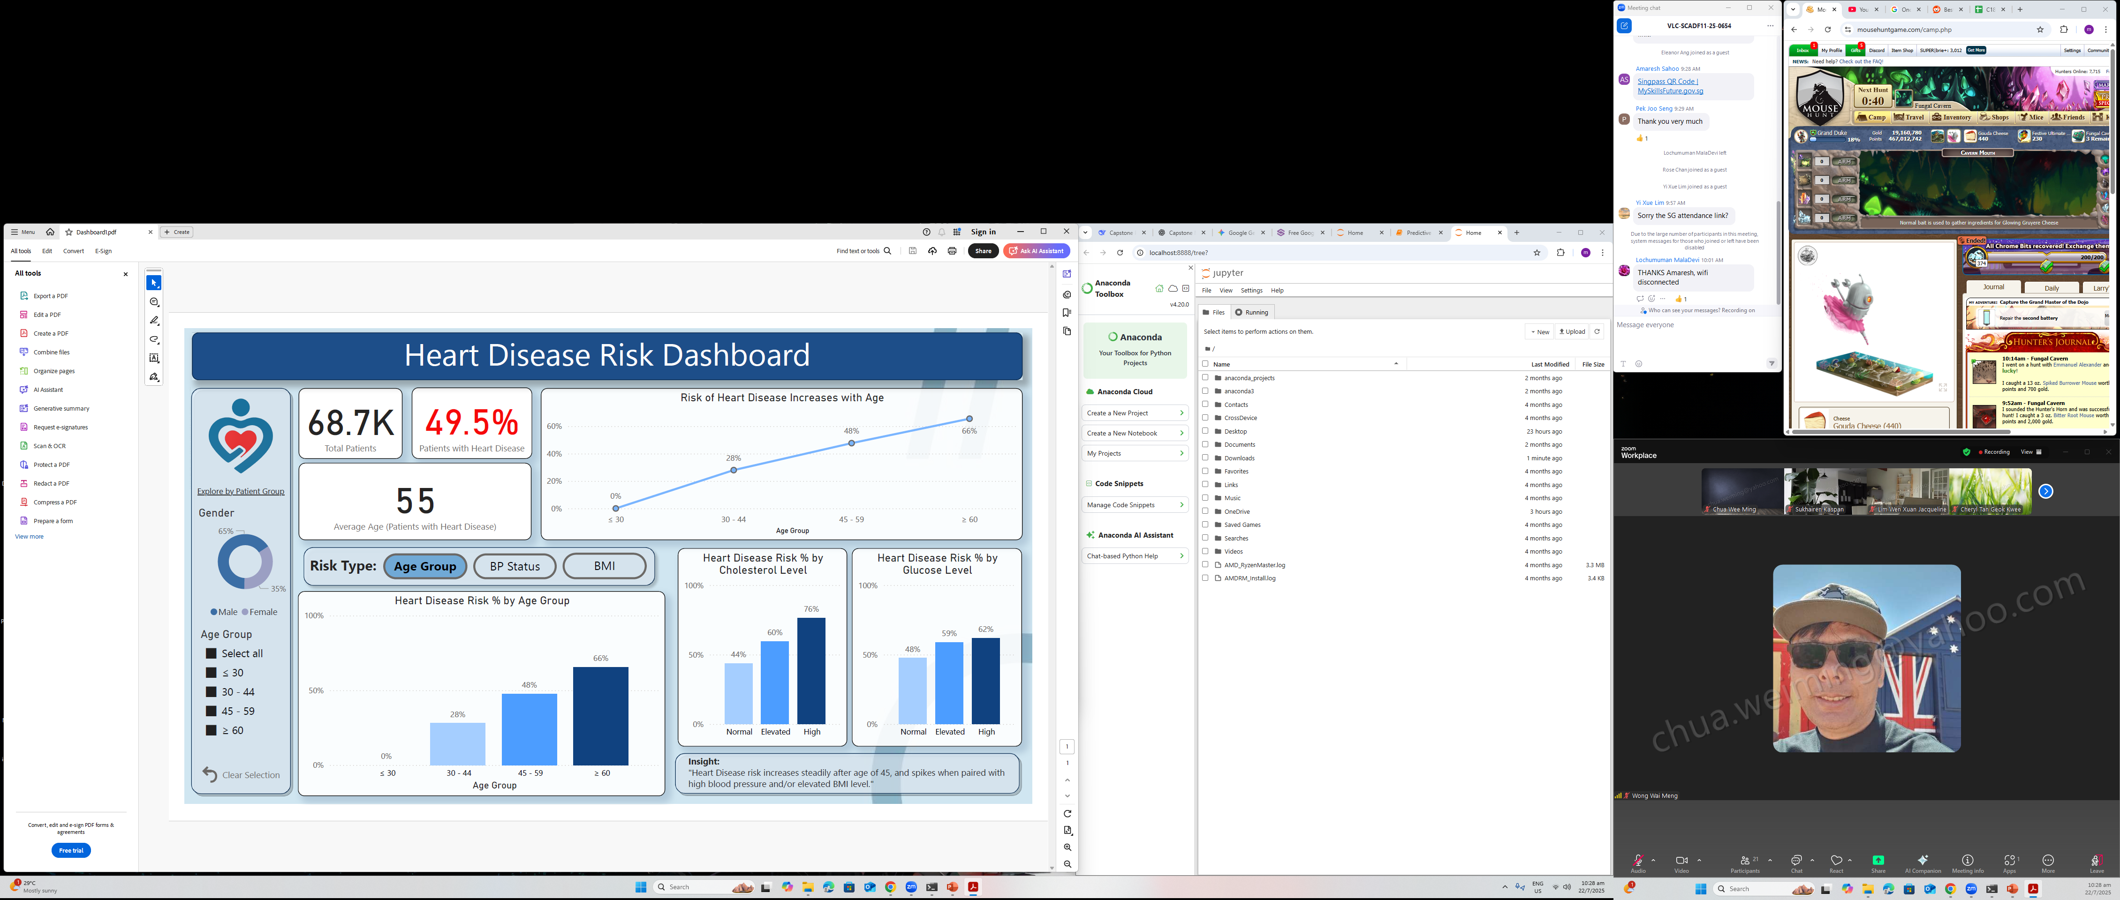
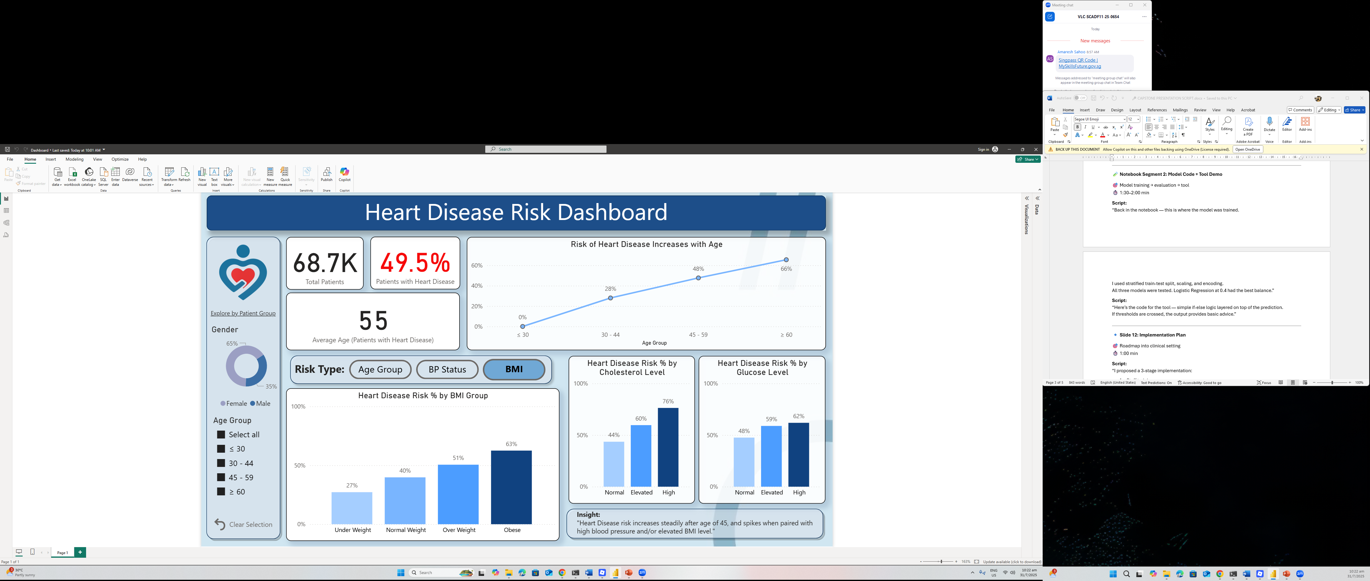

Slide 9
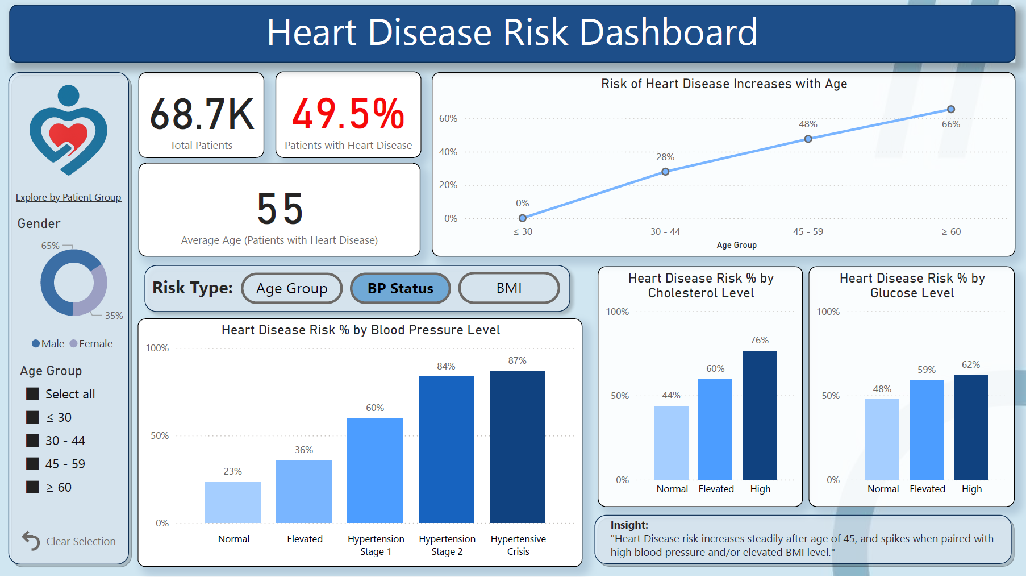

Slide 10
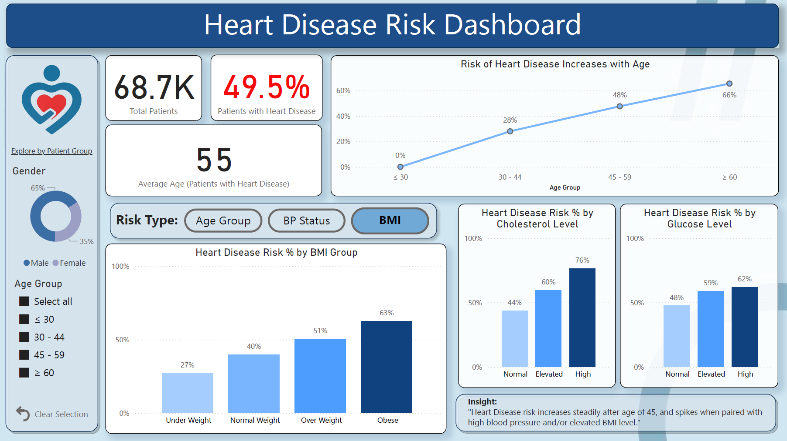

Slide 11
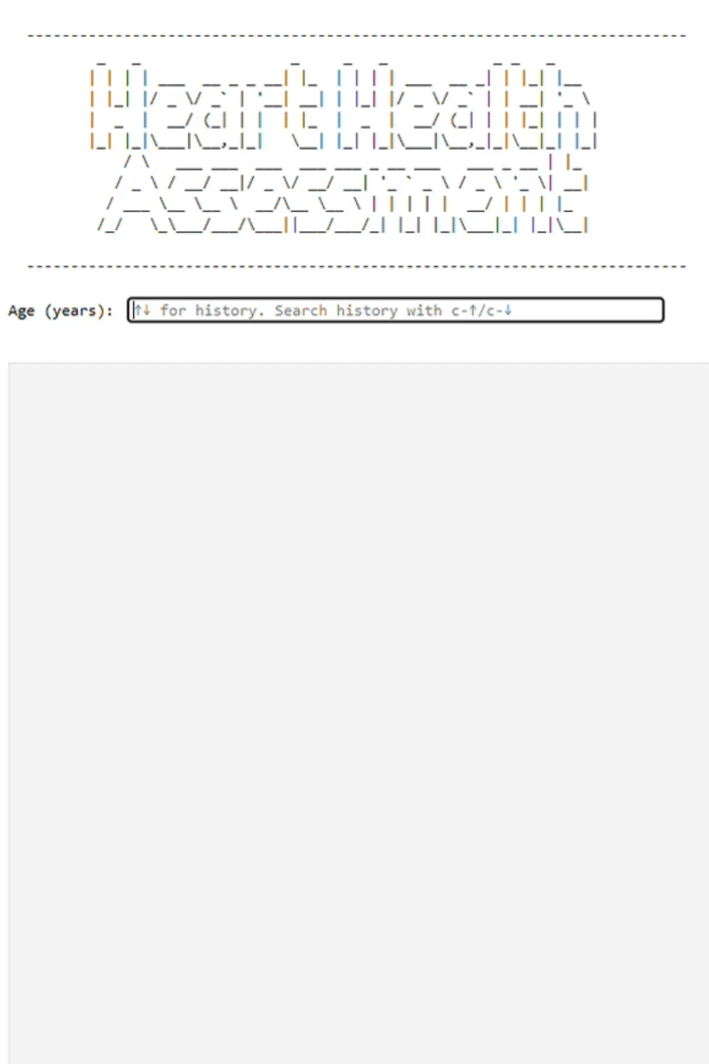
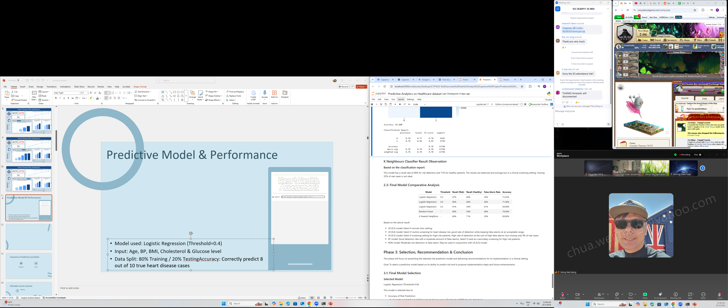
Predictive Model & Performance
Result of 3 models tested:
Model Chosen: Logistic Regression (Threshold=0.4)
Input: Age, BP, BMI, Cholesterol & Glucose level
Data Split: 80% Training / 20% Testing
Accuracy: Correctly predict 8 out of 10 true heart disease cases

Slide 12
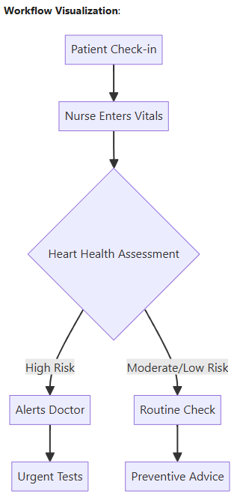
Clinical Implementation Plan
Stage 1: Staff Training (1 Hour)
• How to input vitals correctly
• How to interpret alerts and recommendations
• When to trust or override the model
• Hands-on with simulated cases
Stage 2: Trial Run (4 - 6 Weeks)
• Run in 2+ clinics
• Track: time saved, early detections, staff feedback
Stage 3: Rollout Decision
• Success if:
- 50% time reduction per screening
- 75% risk detection rate
- 80% and above staff approval
• If criteria not met: retrain, adjust threshold, retest

Slide 13
Model Insights
Model Limitations | Future Enhancements
Missing Key Predictors: Important information such as family history, ECG result, or lifestyle details, which are not available in the dataset. Data Reliability: Features such as smoking or physical activeness were included in the dataset, but EDA reveals that they are not impactful to the analysis. This may be due to patients underreporting. Updates Required: Once deployed, the model needs to be retrained with new data to improve. Over time, the model will become outdated due to changes in medical trends and patient profiles. Prediction, not diagnosis: The model predicts and flags patients with high risk of heart disease, not confirms a diagnosis. It is there to support and not replace medical professionals | Include More Predictors: Adding more medical data such as family history, ECG results, or detailed lifestyle patterns could improve the model’s prediction accuracy. Long-Term Integration: The tool could be connected to visual dashboards or patient databases to automatically retrieve vitals, show alerts, and assist in day-to-day operations in real time. Retrain with Feedback: As the tool is used, the results can be collected and reused to retrain the model regularly so that it improves over time as more data is collected. Mobile App Version: A simple mobile-friendly version could be developed for use as a self-check tool for patients before visiting a doctor. This could reduce screening time even more and help with early risk identification, even at home.

Slide 14
Final Reflections
Started with a Problem Statement
Can we use basic patient data to flag heart disease risk early?
Cleaned and Prepared the Data
70,000 rows cleaned and simplified into key features
Created a Dashboard with Cleaned Data
Meaningful KPIs and Charts with cleaned data
Visuals show clearly how features affect heart disease risk
Built a Predictive Model
Logistic Regression tuned to increase recall rate over accuracy
Achieved 81% accuracy, programmed output to be easily understood
Next Steps
Mobile-friendly version
Feedback loop and retraining
Full integration into clinical workflow
Key Takeaway
Working on this project has shown me that with proper cleaning, modeling, and a purpose, even a simple dataset can reveal analytical insights and provide data for a useful tool like this risk assessor.

